Slide 1
12V DC Air Conditioning Comparison Testing Results

Slide 2
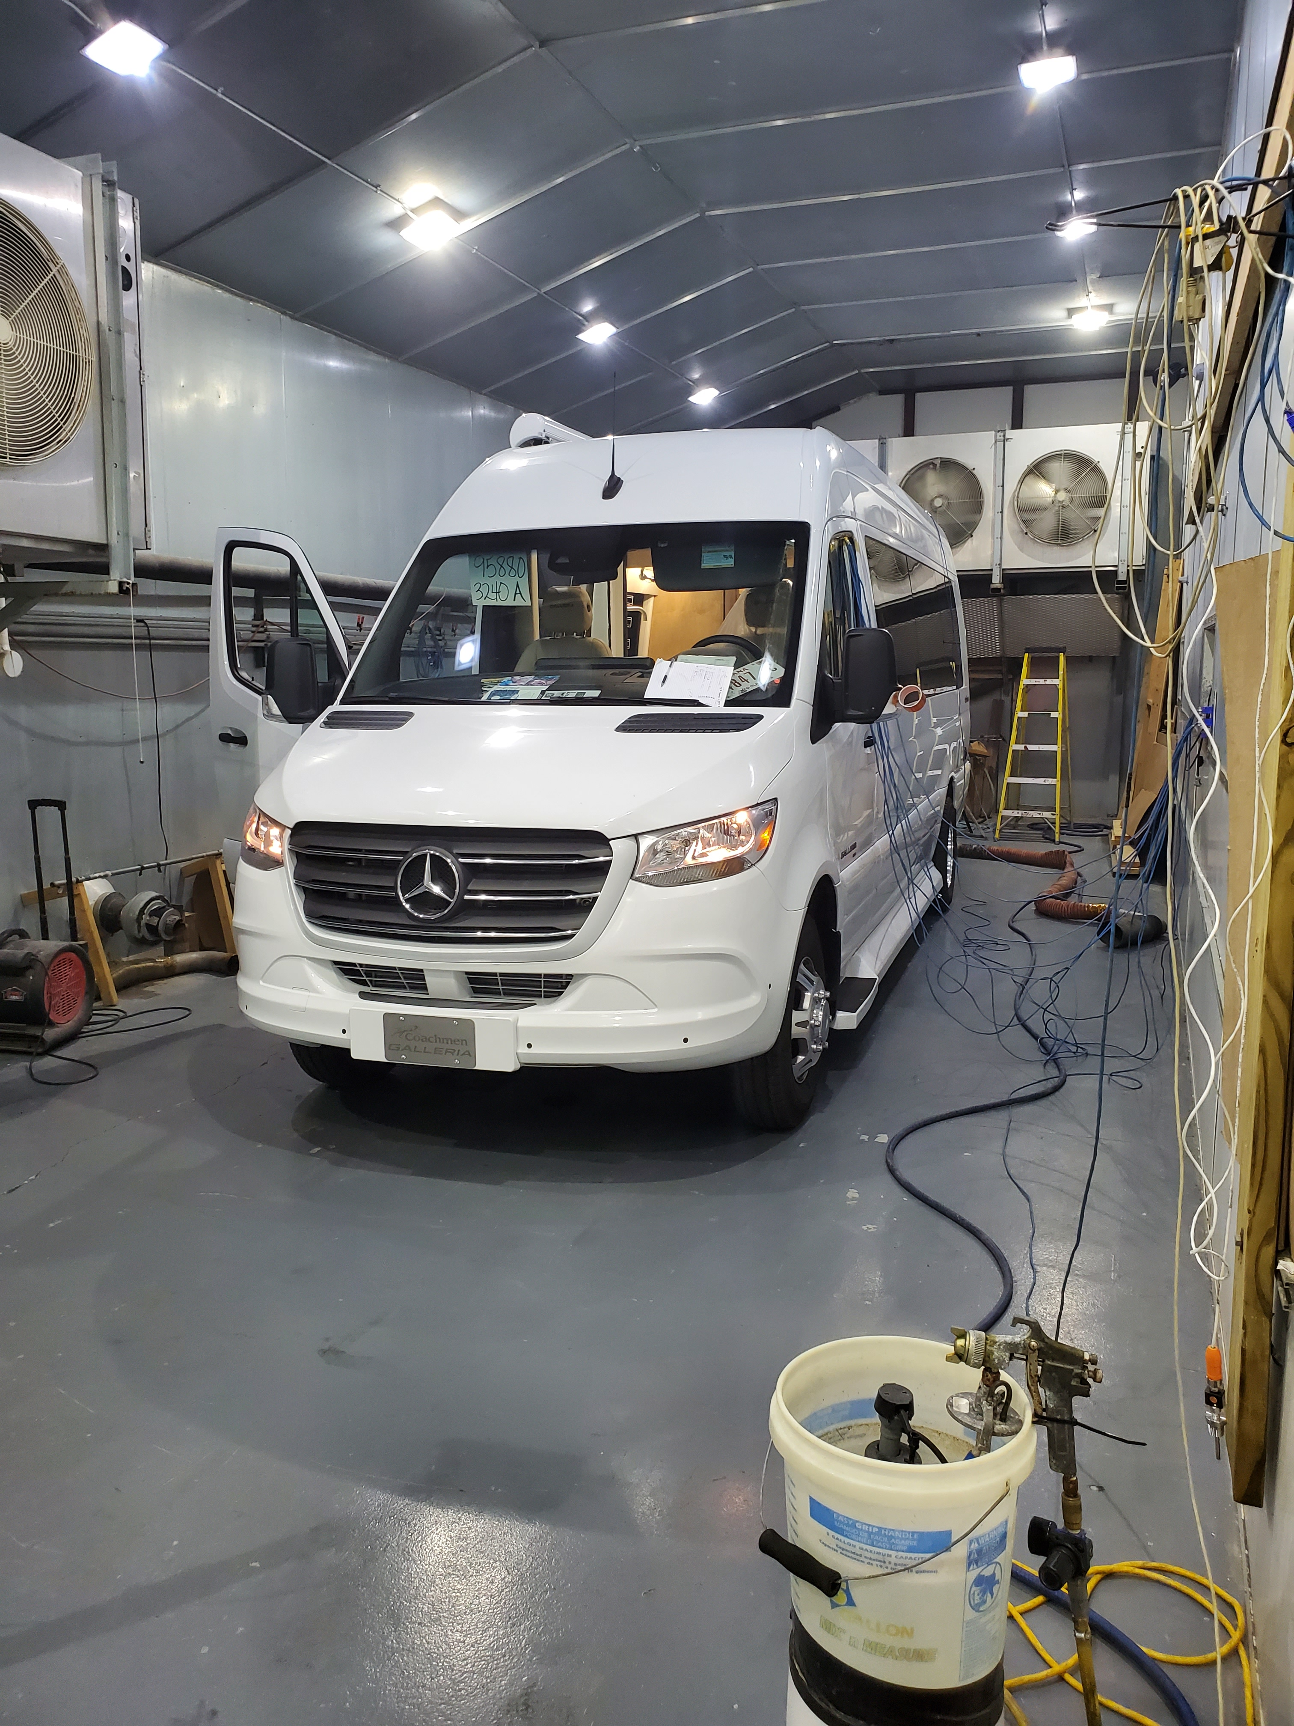
Test Parameters
125 Degree Ambient Heat Chamber
45% Relative Humidity
Test Description: The Class B RV was allowed to “Soak” in the booth conditions with all doors open for 2 hours to allow all Temperature Sensors to warm to a minimum of 120 degrees F. At the conclusion of the “Heat Soak,” all doors were closed, the Air Conditioner was turned on Max, and data was collected for 75 minutes. 11 Temperature sensors were placed throughout the test booth both internal and external

Slide 3
Sensor 1 | Front Exterior Ambient | 3 Ft from front of van, 5 ft off of floor level
Sensor 2 | Rear Exterior Ambient | 3 Ft from rear of van, 5 ft off of floor level
Sensor 3 | Air Return | Air Return Grill of Air Conditioner
Sensor 4 | Front Vent | Forward facing outlet air vent of air conditioner
Sensor 5 | Rear Vent | Rear facing outlet of air vent of air conditioner
Sensor 6 | Rear Lower | 6” from Bed surface directly under air conditioner
Sensor 7 | Not Used
Sensor 8 | Fan High | Center of vehicle below exhaust fan
Sensor 9 | Front Low | Front of passenger compartment near floor, across from sliding entry door
Sensor 10 | Front High | Front of passenger compartment near ceiling, across from sliding entry door
Sensor 11 | Fan Low | Directly below exhaust fan, near floor
Sensor 12 | Compressor Ambient | Under exterior air conditioner cover

Slide 4
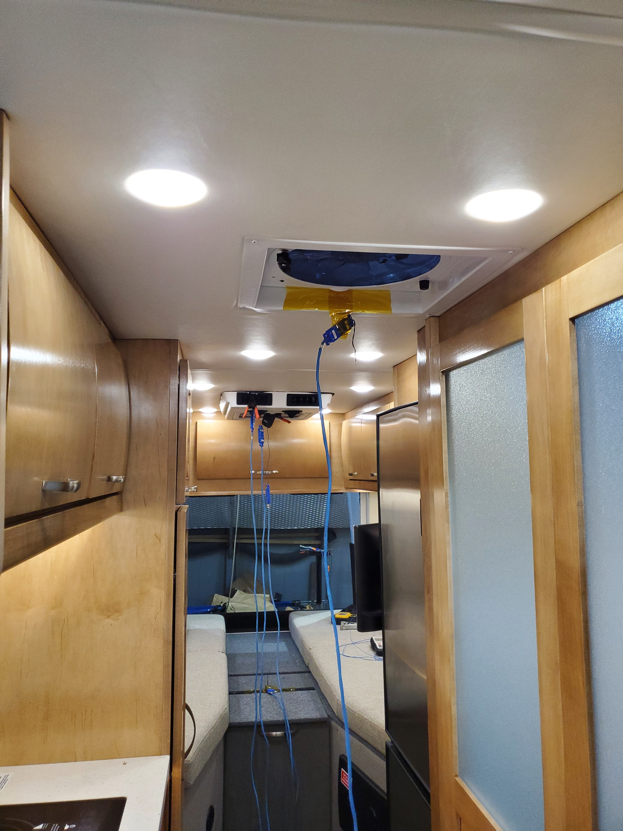
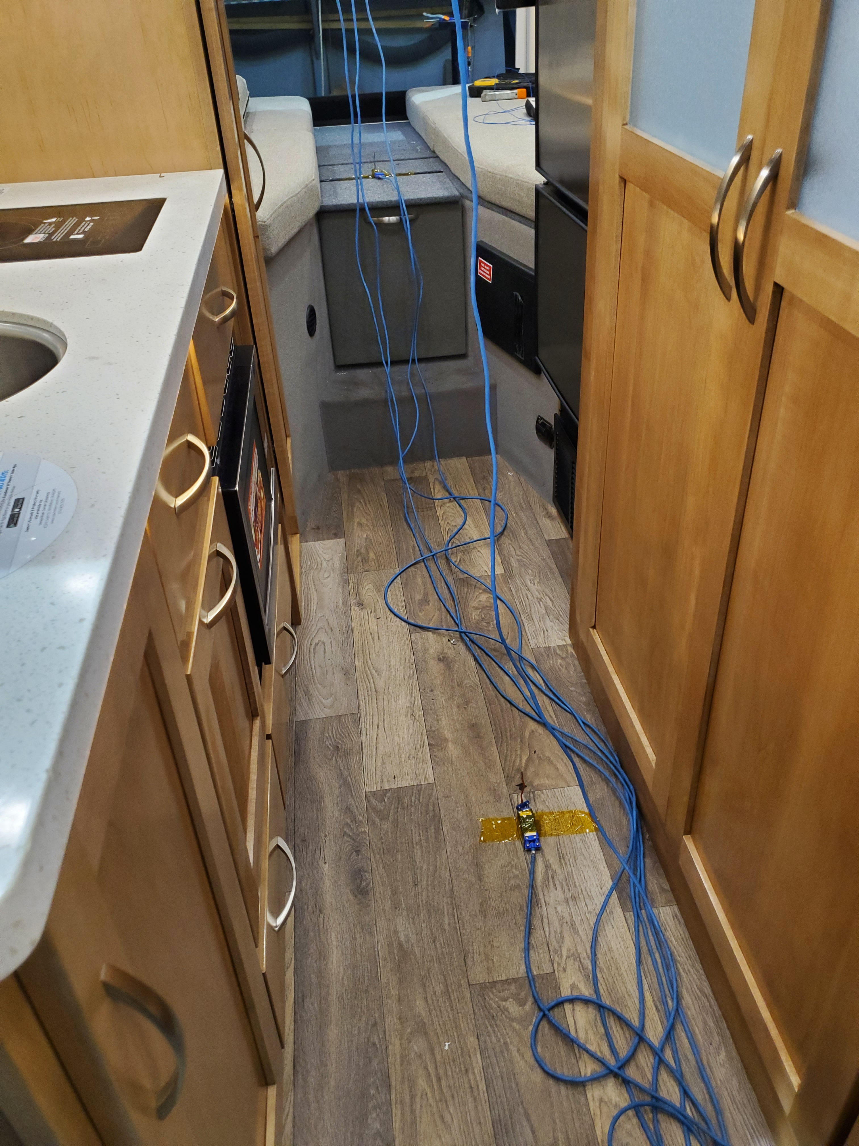
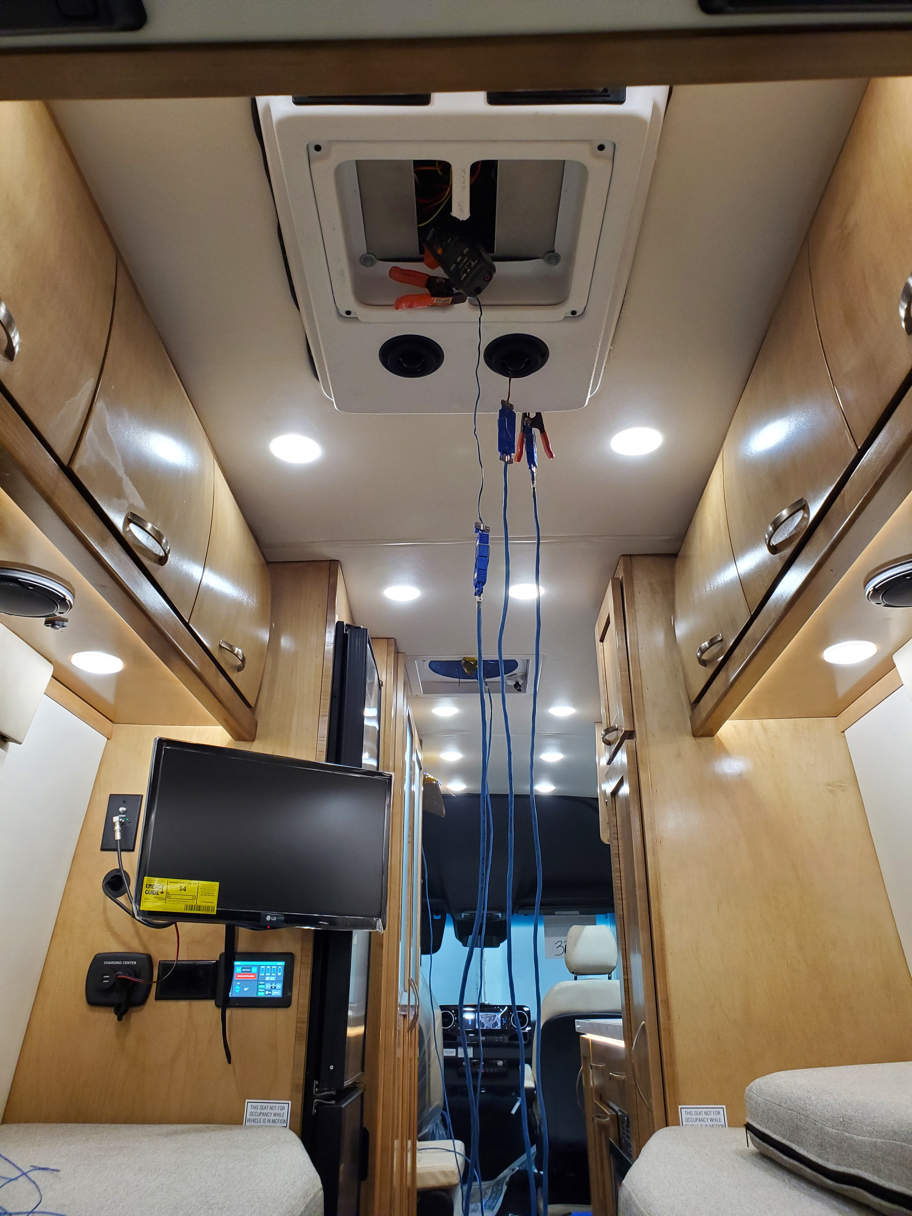
Internal Temp Sensor Locations

Slide 5
Test Results

Slide 6
The Premier System utilizes a soft start compressor, which slowly ramps the compressor up to speed over a 3-5 minute time period. In the extreme conditions of the test, this can be seen by faster initial temp drops form the Brand X unit. At the conclusion of the test, average probe temperatures were equivalent to the Brand X unit. The soft start compressor is used to prolong compressor and battery life and reliability.

Slide 7
Air Flow:
Brand X: 250 CFM
Premier: 285 CFM

Slide 8
Average Amp Draw Through Entire Test
Brand X: 125 Amps
Premier: 80 Amps
Utilizing 2/3 of the power consumption, the Premier System effectively cooled the vehicle while providing 15% more air flow.

